Slide 1
DECODER
PREPARED BY
Mr.P.KANAKARAJ
AP/EEE
SRMIST-KTR

Slide 2
Decoder:
It is a combinational logic circuit.
It has an n-bit binary input code and a one activated output out of 2^{n} output code is called binary decoder.
A binary decoder is used when it is necessary to activate exactly one of 2^{n} outputs based on an n-bit input value.
It is similar to demultiplexer, with only one exception that it has no data input.
Input – n
Output – 2^{n}
Decoder – n : 2^{n}
There is a Enable input, which is required to connect two or three decoder in parallel.
DECODER
n:2^{n}
2^{n}
Output Lines
n
Input Lines
Enable Input

Slide 3
Decoder Vs Demultiplexer
Decoder
Decoder is a many inputs to many outputs device.
There are no selection lines.
Demultiplexer
Demultiplexer is a one input to many outputs device.
The selection of specific output line is controlled by the value of selection lines.

Slide 4
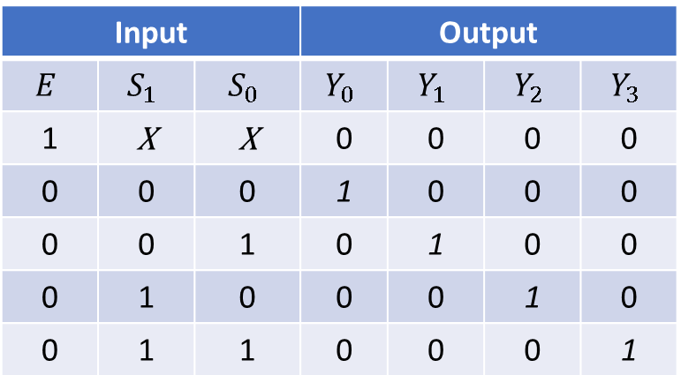
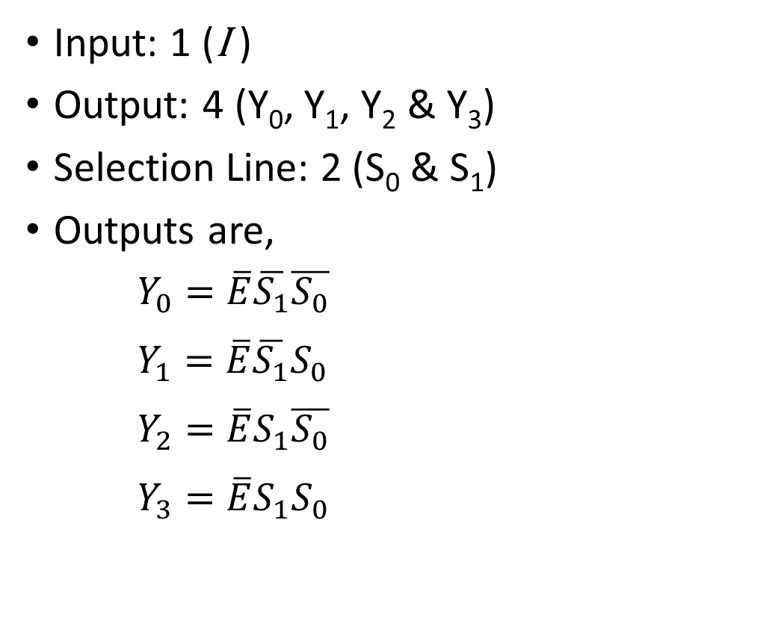
Design of 2:4 DECODER
Truth Table
Input: 1 (I )
Output: 4 (Y₀, Y₁, Y₂ & Y₃)
Selection Line: 2 (S₀ & S₁)
Outputs are,
$Y_{0}=\overline{E}\overline{S_{1}}\overline{S_{0}}$
$Y_{1}=\overline{E}\overline{S_{1}}S_{0}$
$Y_{2}=\overline{E}S_{1}\overline{S_{0}}$
$Y_{3}=\overline{E}S_{1}S_{0}$
Input |  |  | Output
$$E$$ | $$S_{1}$$ | $$S_{0}$$ | $$Y_{0}$$ | $$Y_{1}$$ | $$Y_{2}$$ | $$Y_{3}$$
1 | X | X | 0 | 0 | 0 | 0
0 | 0 | 0 | 1 | 0 | 0 | 0
0 | 0 | 1 | 0 | 1 | 0 | 0
0 | 1 | 0 | 0 | 0 | 1 | 0
0 | 1 | 1 | 0 | 0 | 0 | 1

Slide 5
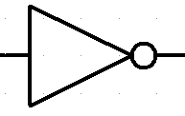
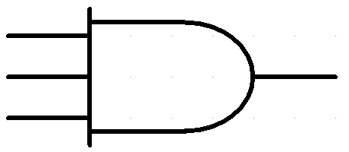





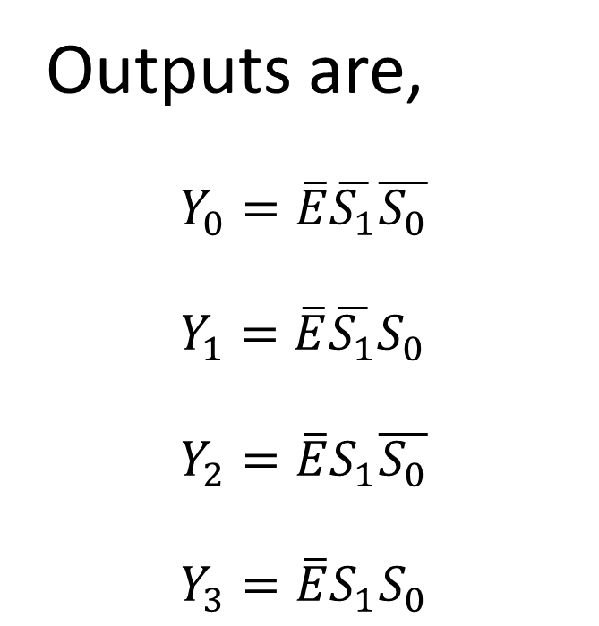








$$E$$
$$S_{1}$$
$$S_{0}$$
Logic Diagram of 2:4 Decoder
$$\overline{S_{1}}$$
$$\overline{S_{0}}$$
Outputs are,
$Y_{0}=\overline{E}\overline{S_{1}}\overline{S_{0}}$
$Y_{1}=\overline{E}\overline{S_{1}}S_{0}$
$Y_{2}=\overline{E}S_{1}\overline{S_{0}}$
$Y_{3}=\overline{E}S_{1}S_{0}$
$$Y_{0}$$
$$=\overline{E}\overline{S_{1}}\overline{S_{0}}$$
$$Y_{1}$$
$$=\overline{E}\overline{S_{1}}S_{0}$$
$$Y_{2}$$
$$=\overline{E}S_{1}\overline{S_{0}}$$
$$Y_{3}$$
$$=\overline{E}S_{1}S_{0}$$

Slide 6













2 to 4 Line Decoder
2 to 4
Decoder
$$S_{0}$$
$$S_{1}$$
$$Y_{0}$$
$$Y_{0}$$
$$Y_{1}$$
$$Y_{1}$$
$$Y_{2}$$
$$Y_{2}$$
$$S_{0}$$
$$S_{1}$$
$$Y_{3}$$
$$Y_{3}$$
$$\overline{E}$$

Slide 7






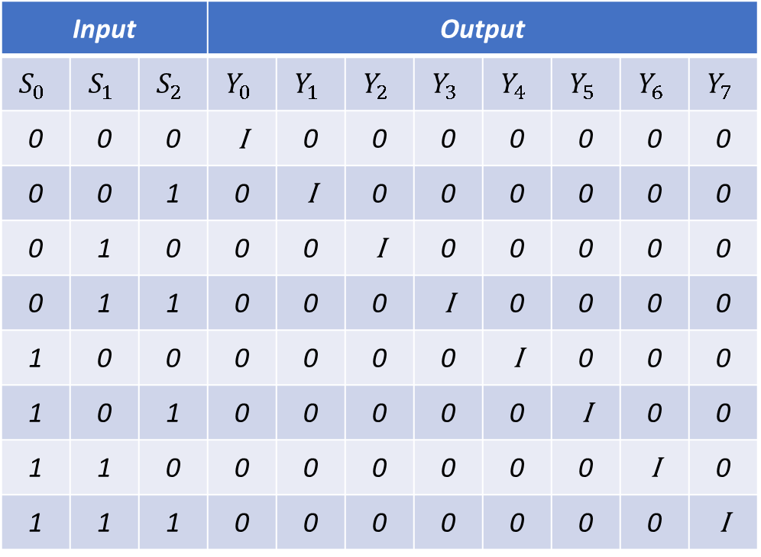


Three to Eight line Decoder
Truth Table
Input |  |  | Output
$$S_{0}$$ | $$S_{1}$$ | $$S_{2}$$ | $$Y_{0}$$ | $$Y_{1}$$ | $$Y_{2}$$ | $$Y_{3}$$ | $$Y_{4}$$ | $$Y_{5}$$ | $$Y_{6}$$ | $$Y_{7}$$
0 | 0 | 0 | I | 0 | 0 | 0 | 0 | 0 | 0 | 0
0 | 0 | 1 | 0 | I | 0 | 0 | 0 | 0 | 0 | 0
0 | 1 | 0 | 0 | 0 | I | 0 | 0 | 0 | 0 | 0
0 | 1 | 1 | 0 | 0 | 0 | I | 0 | 0 | 0 | 0
1 | 0 | 0 | 0 | 0 | 0 | 0 | I | 0 | 0 | 0
1 | 0 | 1 | 0 | 0 | 0 | 0 | 0 | I | 0 | 0
1 | 1 | 0 | 0 | 0 | 0 | 0 | 0 | 0 | I | 0
1 | 1 | 1 | 0 | 0 | 0 | 0 | 0 | 0 | 0 | I
Input: 3 (S₀, S₁ , S₂ )
Output: 8 (Y₀, Y₁, Y₂, Y₃, Y₄, Y₅, Y₆, Y₇)
Outputs are,
$$Y_{0}=\overline{S_{2}}\overline{S_{1}}\overline{S_{0}}$$
$$Y_{4}=S_{2}\overline{S_{1}}\overline{S_{0}}$$
$$Y_{1}=\overline{S_{2}}\overline{S_{1}}S_{0}$$
$$Y_{5}=S_{2}\overline{S_{1}}S_{0}$$
$$Y_{2}=\overline{S_{2}}S_{1}\overline{S_{0}}$$
$$Y_{6}=S_{2}S_{1}\overline{S_{0}}$$
$$Y_{3}=\overline{S_{2}}S_{1}S_{0}$$
$$Y_{7}=S_{2}S_{1}S_{0}$$

Slide 8
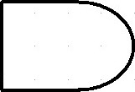




























Logic Diagram of 3 to 8 line Decoder
$$S_{2}$$
$$S_{1}$$
$$S_{0}$$
$$\overline{S_{2}}$$
$$\overline{S_{1}}$$
$$\overline{S_{0}}$$
Outputs are,
$$Y_{0}$$
$$=\overline{S_{2}}\overline{S_{1}}\overline{S_{0}}$$
$$Y_{0}=\overline{S_{2}}\overline{S_{1}}\overline{S_{0}}$$
$$Y_{4}=S_{2}\overline{S_{1}}\overline{S_{0}}$$
$$Y_{1}$$
$$=\overline{S_{2}}\overline{S_{1}}S_{0}$$
$$Y_{1}=\overline{S_{2}}\overline{S_{1}}S_{0}$$
$$Y_{5}=S_{2}\overline{S_{1}}S_{0}$$
$$Y_{2}$$
$$=\overline{S_{2}}S_{1}\overline{S_{0}}$$
$$Y_{3}$$
$$=\overline{S_{2}}S_{1}S_{0}$$
$$Y_{2}=\overline{S_{2}}S_{1}\overline{S_{0}}$$
$$Y_{6}=S_{2}S_{1}\overline{S_{0}}$$
$$Y_{4}$$
$$=S_{2}\overline{S_{1}}\overline{S_{0}}$$
$$Y_{3}=\overline{S_{2}}S_{1}S_{0}$$
$$Y_{7}=S_{2}S_{1}S_{0}$$
$$Y_{5}$$
$$=S_{2}\overline{S_{1}}S_{0}$$
$$Y_{6}$$
$$=S_{2}S_{1}\overline{S_{0}}$$
$$Y_{7}$$
$$=S_{2}S_{1}S_{0}$$

Slide 9




















3 to 8 Line Decoder
3 to 8
Decoder
$$Y_{0}$$
$$Y_{0}$$
$$Y_{1}$$
$$Y_{1}$$
$$Y_{2}$$
$$Y_{2}$$
$$S_{0}$$
$$S_{1}$$
$$S_{2}$$
$$Y_{3}$$
$$Y_{3}$$
$$Y_{4}$$
$$Y_{4}$$
$$S_{0}$$
$$S_{1}$$
$$S_{2}$$
$$Y_{5}$$
$$Y_{5}$$
$$Y_{6}$$
$$Y_{6}$$
$$Y_{7}$$
$$Y_{7}$$
$$\overline{E}$$

Slide 10


















Design of 3 to 8 line Decoder Using 2 to 4 line Decoder
2 to 4
Decoder
$$Y_{0}$$
$$Y_{0}$$
$$Y_{1}$$
$$Y_{1}$$
$$S_{0}$$
$$S_{0}$$
$$S_{1}$$
$$S_{1}$$
$$Y_{2}$$
$$Y_{2}$$
$$Y_{3}$$
$$Y_{3}$$
$$S_{2}$$
$$\overline{E}$$
2 to 4
Decoder
$$Y_{4}$$
$$Y_{4}$$
$$S_{0}$$
$$Y_{5}$$
$$Y_{5}$$
$$S_{1}$$
$$Y_{6}$$
$$Y_{6}$$
$$Y_{7}$$
$$Y_{7}$$
$$\overline{E}$$

Slide 11
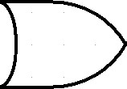





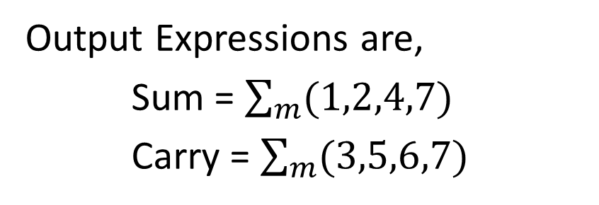








Implementation of Full Adder using Decoder
Truth Table
Decimal | Inputs |  |  | Outputs
 | A | B | C | Sum | Carry
0 | 0 | 0 | 0 | 0 | 0
1 | 0 | 0 | 1 | 1 | 0
2 | 0 | 1 | 0 | 1 | 0
3 | 0 | 1 | 1 | 0 | 1
4 | 1 | 0 | 0 | 1 | 0
5 | 1 | 0 | 1 | 0 | 1
6 | 1 | 1 | 0 | 0 | 1
7 | 1 | 1 | 1 | 1 | 1
3 to 8
Decoder
$$Y_{0}$$
$$Y_{1}$$
$$Sum$$
$$Y_{2}$$
$$A$$
$$B$$
$$C$$
$$Y_{3}$$
$$Y_{4}$$
$$A$$
$$B$$
$$C$$
$$Carry$$
$$Y_{5}$$
$$Y_{6}$$
$$\overline{E}$$
$$Y_{7}$$
Output Expressions are,
Sum = $\sum_{m}{(1,2,4,7)}$
Carry = $\sum_{m}{(3,5,6,7)}$

Slide 12





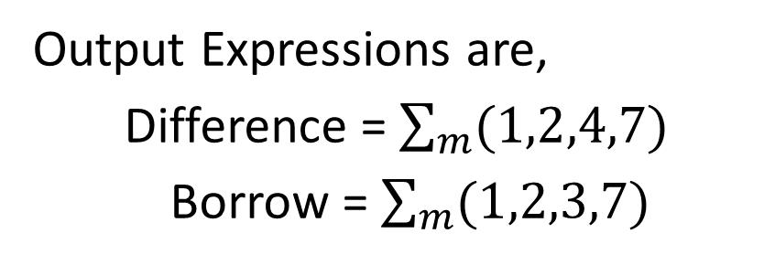









Implementation of Full Subtractor using Demultiplexer
Truth Table
Decimal | Inputs |  |  | Outputs
 | A | B | C | Difference | Borrow
0 | 0 | 0 | 0 | 0 | 0
1 | 0 | 0 | 1 | 1 | 1
2 | 0 | 1 | 0 | 1 | 1
3 | 0 | 1 | 1 | 0 | 1
4 | 1 | 0 | 0 | 1 | 0
5 | 1 | 0 | 1 | 0 | 0
6 | 1 | 1 | 0 | 0 | 0
7 | 1 | 1 | 1 | 1 | 1
3 to 8
Decoder
$$Y_{0}$$
$$Y_{1}$$
$$Difference$$
$$Y_{2}$$
$$A$$
$$B$$
$$C$$
$$Y_{3}$$
$$Y_{4}$$
$$A$$
$$B$$
$$C$$
$$Borrow$$
$$Y_{5}$$
$$Y_{6}$$
$$\overline{E}$$
$$Y_{7}$$
Output Expressions are,
Difference = $\sum_{m}{(1,2,4,7)}$
Borrow = $\sum_{m}{(1,2,3,7)}$

Slide 13


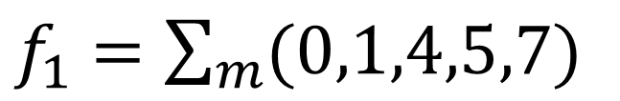




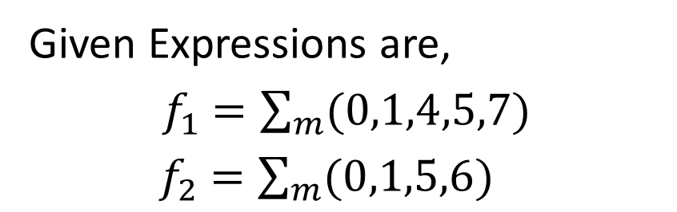





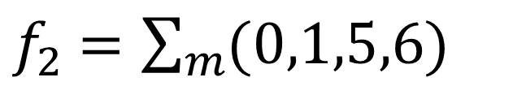



Implementation of given Boolean function using Decoder
$f_{1}$ $=\sum_{m}{(0,1,4,5,7)}$
$f_{2}$ $=\sum_{m}{(0,1,5,6)}$
Given Expressions are,
$f_{1}$ $=\sum_{m}{(0,1,4,5,7)}$
$f_{2}$ $=\sum_{m}{(0,1,5,6)}$
3 to 8
Decoder
$$Y_{0}$$
$$Y_{1}$$
$$f_{1}$$
$$Y_{2}$$
$$A$$
$$B$$
$$C$$
$$Y_{3}$$
$$Y_{4}$$
$$A$$
$$B$$
$$C$$
$$f_{2}$$
$$Y_{5}$$
$$Y_{6}$$
$$\overline{E}$$
$$Y_{7}$$

Slide 14
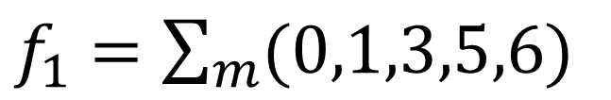
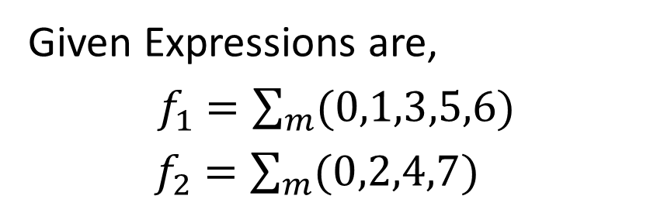
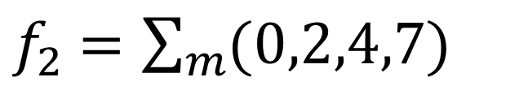
Implementation of given Boolean function using Decoder
$f_{1}$ $=\sum_{m}{(0,1,3,5,6)}$
$f_{2}$ $=\sum_{m}{(0,2,4,7)}$
Given Expressions are,
$f_{1}$ $=\sum_{m}{(0,1,3,5,6)}$
$f_{2}$ $=\sum_{m}{(0,2,4,7)}$
3 to 8
Decoder
$$Y_{0}$$
$$Y_{1}$$
$$f_{1}$$
$$Y_{2}$$
$$A$$
$$B$$
$$C$$
$$Y_{3}$$
$$Y_{4}$$
$$A$$
$$B$$
$$C$$
$$f_{2}$$
$$Y_{5}$$
$$Y_{6}$$
$$\overline{E}$$
$$Y_{7}$$

Slide 15
Applications of Decoder
It can be used to implement combinational circuit
It can be used to convert BCD into 7-segment code
It is used in memories to select particular register

Slide 16
THANK YOU…

Slide 17
ANY QUERIEES???…

